Slide 1

Prediction For Incidence of Alzheimer’s disease using neural networks

Slide 2

Overview:
Introduction to Alzheimer’s disease
Dataset Used
Data Pre-Processing
Neural Network Strategy/Architecture
Model Evaluation
Drawbacks & Improvements
Results
Future Scope
References

Slide 3

What is Alzheimer’s Disease?
According to the Alzheimer's Association, Alzheimer's disease(AD) is a type of dementia that affects memory, thinking and behavior.
Dementia is a general term for memory loss and other cognitive abilities serious enough to interfere with daily life.
Symptoms: Difficulty remembering newly learned information, confusion, memory loss cognitive disabilities.
Cause: Unknown(Greatest known risk factor is age)
Cure: Unknown

Slide 4

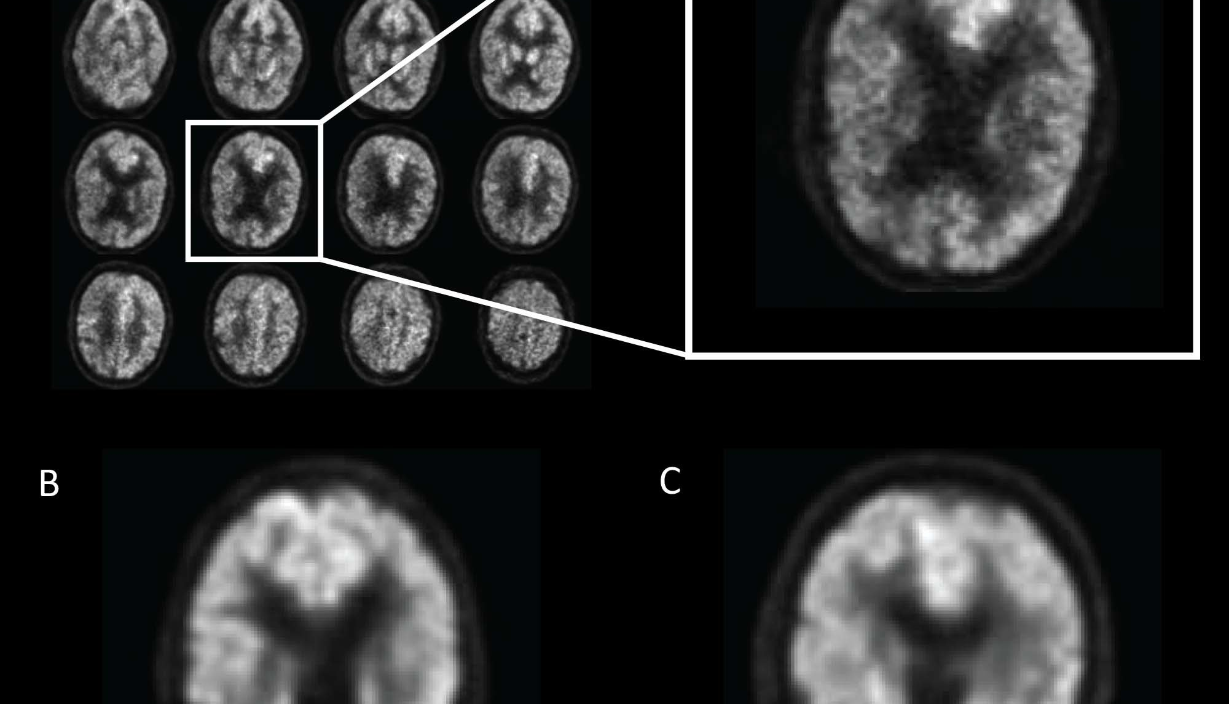
Dataset Used
MRI and Alzheimer's by OASIS group.
Open Access Series of Imaging Studies (OASIS) aims to provide MRI datasets of the brain freely accessible to the scientific community.
Contains 2 raw datasets:
oasis cross-sectional (434 data samples)
oasis longitudinal (373 data samples)

Slide 5
Data Pre-processing
Variable Name: | Variable Description:
ID | Identification
M/F | Gender (M if Male, F if Female)
Hand | Handedness
Age | Age in years
EDUC | Years of education
SES | Socioeconomic Status
MMSE | Mini Mental State Examination
CDR | Clinical Dementia Rating
eTIV | Estimated Total Intracranial Volume
nWBV | Normalize Whole Brain Volume
ASF | Atlas Scaling Factor
Delay | Delay
Visit | Number of visits to the doctor
Group | the state of the patient
(15 features reduced to 8 features)
M/F Predicted Value: Clinical Dementia Rating
Age
Educ
SES
MMSE
eTIV
nWBV
ASF
CDR Value | Clinical Judgement
0 | Normal
0.5 | Very mild Dementia
1 | Mild Dementia
2 | Moderate Dementia

Slide 6
Data Pre-processing (contd.)
Imputing Missing Values :
Label Encoding (String to Int)
Gender (M → 1, F → 0)
203/809 (Replaced by Most Frequent)
239/809 (Replaced by Most Frequent)
99/809 (Replaced by Median)
Educ
SES
MMSE

Slide 7
Neural Network Architecture
CDR Value | Equivalent Representatives (Octave)
1 | 1
2 | 2
0 | 3
0.5 | 4
8 input nodes (1 node for every chosen feature)
14 hidden nodes (Best out of 8,10,12,15 & 20)
4 output nodes (Each CDR value as 0,0.5,1,2)

Slide 8
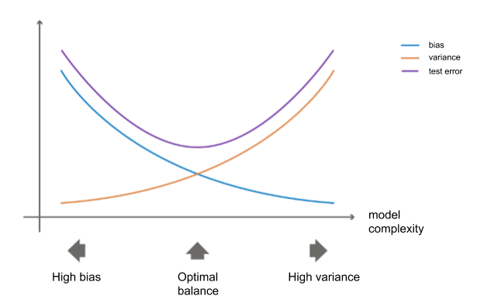

Model Evaluation
Best found parameters:
Lambda = 0.5
Max_Iters : 500
Training Accuracy : 63.23%
CV Accuracy : 55.12%
Test Accuracy: 52%
High bias

Slide 9


Project analysis slide 8
Drawbacks and Improvements
Drawbacks
Improvements
Less no. of examples
Less no. of features
Too many missing values (hence, more approximations that in turn led to generalization of the model)
Simple network architecture (Just 1 hidden layer with 14 nodes)
Simple Activation Function (Sigmoid)
Decreased Lambda
Introduced polynomial features (degree=2 & 3) [Total features increased from 8 to 15]
Age_squared, MMSE_squared, SSE_squared, eTIV * ASF, Age * SES, Age * MMSE, Age * EDUC
Complex network architecture (15 input nodes, 14 hidden layer1 nodes, 10 hidden layer2 nodes, 4 output nodes)

Slide 10
Results
Best found parameters:
Lambda = 0.2
Max_Iters : 500
Degree of Polynomial: 2
Training Accuracy : 92.78%
CV Accuracy : 82.16%
Test Accuracy : 79.01%

Slide 11
Future Scope
More Efficient Feature Selection
Collecting And Working With More Samples From OASIS-3 Dataset
Data Synthesis Directly From MR Images
Using A Complex Activation Function
Implement On Random Forest/SVM And Model Comparisons

Slide 12
References
https://www.kaggle.com/ruslankl/dementia-prediction-w-tree-based-models?select=oasis_longitudinal.csv
https://machinelearningmastery.com/polynomial-features-transforms-for-machine-learning/
https://www.alz.org/alzheimers-dementia/facts-figures

Slide 13
Thank You

